Slide 1
BCS202L & BCS202P- Data Structures and Algorithms
Dr. Priyanka N
Assistant Professor Senior Grade 1
School of Computer Science & Engineering
VIT, Vellore.

Slide 2
MERGE SORT
Works under Divide and Conquer strategy
IDEA: Given an sequence of n elements a[1], a[2],……….a[n], the general idea is to imagine them split into two sets a[1],a[2],…a[n/2] and a[n/2+1], ……….a[n].
Each set is individually sorted and the resulting sorted sequences are merged to produce a single sorted sequence of n elements

Slide 3
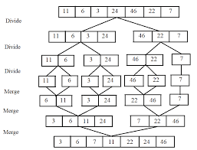

Slide 4
MergeSort(A,lb,ub)
{
if(lb<ub)
{
mid=(lb+ub)/2;
MergeSort(A,lb,mid);
MergeSort(A, mid+1,ub)
MergeSort(A,lb, mid,ub)
}
}

Slide 5
MergeSort(A,lb,mid,ub)
{
i=lb;
J=mid+1;
k=lb;
while(i<=mid && j<=ub)
{
if(a[i]<=a[j])
{
b[k]=a[i];
i++;
}
else
{
b[k]=a[j];
j++;
}
k++;
}
if(i>mid)
{
while(j<=ub)
{
b[k]=a[j];
j++;
k++;
}
else
{
while(i<=mid)
{
b[k]=a[i];
i++;
k++;
}
}
for(k=lb;k<=ub;k++)
{
a[k]=b[k];
}
}

Slide 6
Quick Sort
Quick Sort is a famous sorting algorithm
It sorts the given data items in ascending order
It uses the idea of divide and conquer approach
It follows a recursive algorithm
a = Linear Array in memory
beg = Lower bound of the sub array in question
end = Upper bound of the sub array in question

Slide 7
How Does Quick Sort Works?
It divides the given array into two sections using a partitioning element called as pivot
The division performed is such that-
All the elements to the left side of pivot are smaller than pivot
All the elements to the right side of pivot are greater than pivot
After dividing the array into two sections, the pivot is set at its correct position
Then, sub arrays are sorted separately by applying quick sort algorithm recursively

Slide 8
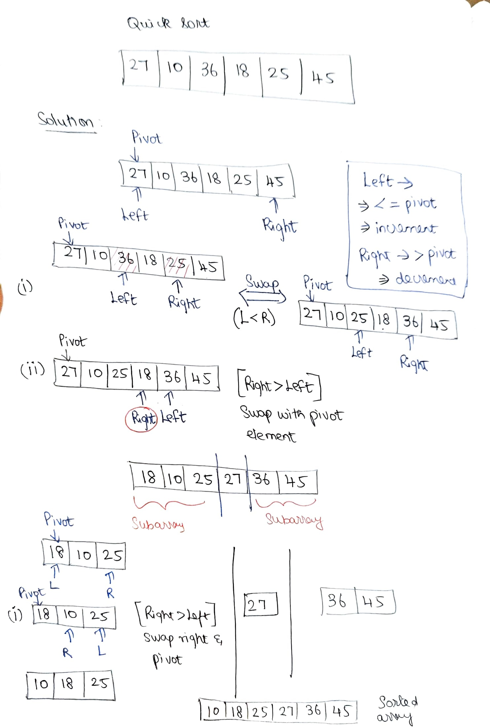

Slide 9
partition(A,lb,ub)
{
pivot = a[lb];
start=lb;
end=ub;
while(start<end)
{
while(a[start]<=pivot)
{
start++;
}
while(a[end]>pivot)
{
end--
}
if(start<end)
{
swap(a[start],a[end])
}
}
swap(a[lb],a[end])
Return end
}
Quicksort(A,lb,ub)
{
If(lb<ub)
{
loc=partition(A,lb,ub)
Quicksort(A,lb,loc-1)
Quicksort(A,loc+1,ub)
}
}

Slide 10
Counting sort
This sorting technique doesn't perform sorting by comparing elements
It performs sorting by counting objects having distinct key values like hashing
After that, it performs some arithmetic operations to calculate each object's index position in the output sequence

Slide 11
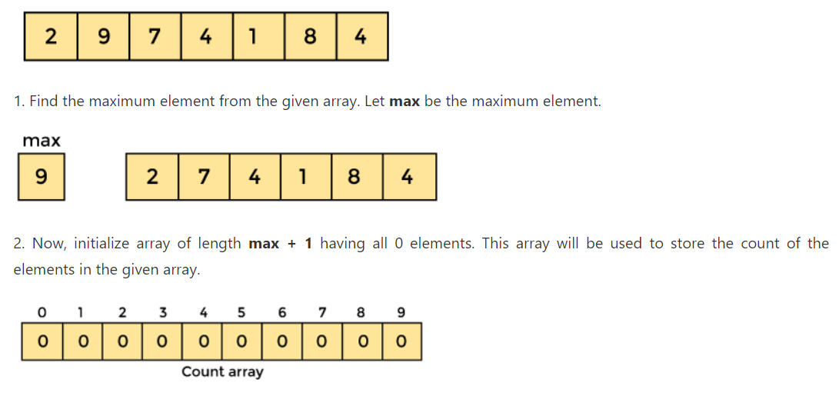
EXAMPLE

Slide 12
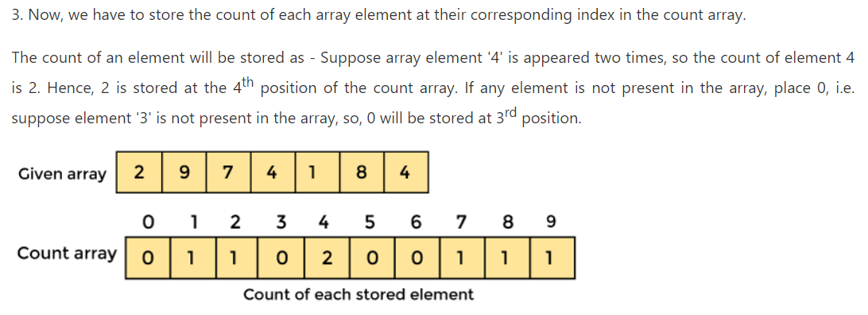

Slide 13
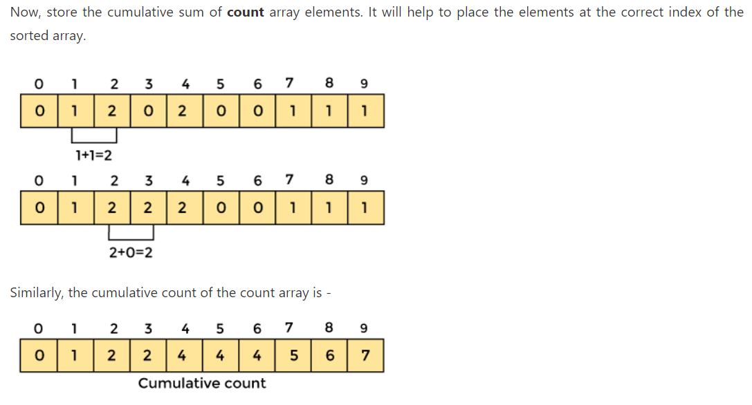

Slide 14
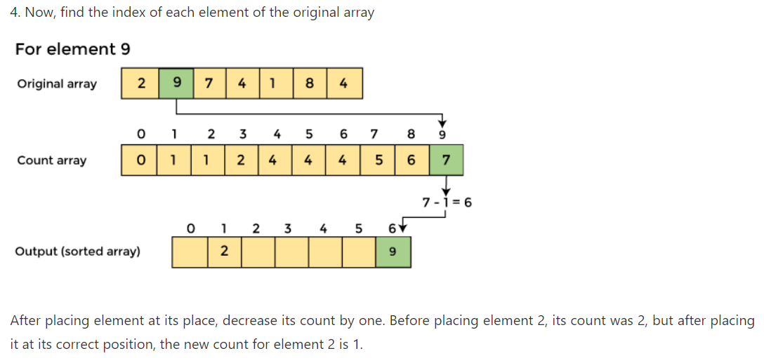

Slide 15
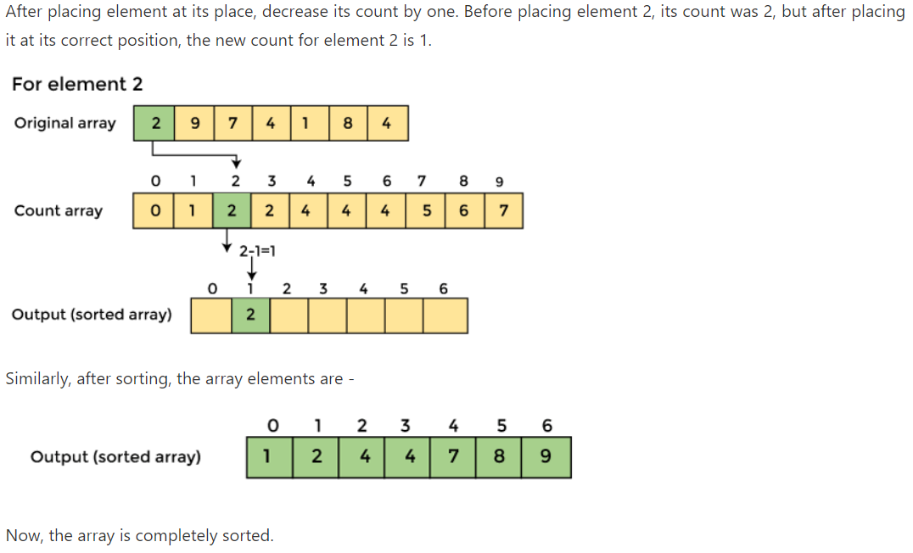

Slide 16
Void countingSort(int A[], int B[], int k, int n)
{
int c[k+1]
for (int i=0; i<=k; i++) //Initialize array to “0”
{
c[i]=0
}
for (int i=0; i<n; i++) //Calculate count value of the array
{
c[A[i]]= c[A[i]]+1
}
for (int i=1; i<=k; i++) //Calculate cumulative count value of the array
{
c[i]= c[i-1]+c[i]
}
for (int i=n-1; i>=0; i--)
{
B[--c[A[i]]]= A[i]
}
for (int i=0; i<n; i++)
{
A[i]= B[i]
}}

Slide 17

